Slide 1
Fundamentals of machine learning
Dr. Noman Islam

Slide 2
Four branches of machine learning- Supervised learning
It consists of learning to map input data to known targets (also called annotations), given a set of examples (often annotated by humans).
Sequence generation—Given a picture, predict a caption describing it. Sequence generation can sometimes be reformulated as a series of classification problems (such as repeatedly predicting a word or token in a sequence).

Slide 3
Syntax tree prediction—Given a sentence, predict its decomposition into a syntax tree.
Object detection—Given a picture, draw a bounding box around certain objects inside the picture. This can also be expressed as a classification problem (given many candidate bounding boxes, classify the contents of each one) or as a joint classification and regression problem, where the bounding-box coordinates are predicted via vector regression.
Image segmentation—Given a picture, draw a pixel-level mask on a specific object.

Slide 4
Unsupervised learning
This branch of machine learning consists of finding interesting transformations of the input data without the help of any targets, for the purposes of data visualization, data compression, or data denoising, or to better understand the correlations present in the data at hand.
Unsupervised learning is the bread and butter of data analytics, and it’s often a necessary step in better understanding a dataset before attempting to solve a supervised-learning problem.
Dimensionality reduction and clustering are well-known categories of unsupervised learning.

Slide 5
Self-supervised learning
Self-supervised learning is supervised learning without human-annotated labels—you can think of it as supervised learning without any humans in the loop.
There are still labels involved (because the learning has to be supervised by something), but they’re generated from the input data, typically using a heuristic algorithm
For instance, autoencoders are a well-known instance of self-supervised learning

Slide 6
Reinforcement learning
In reinforcement learning, an agent receives information about its environment and learns to choose actions that will maximize some reward.
For instance, a neural network that “looks” at a videogame screen and outputs game actions in order to maximize its score can be trained via reinforcement learning

Slide 7
Evaluating machine learning models
We split the data into a training set, a validation set, and a test set.
In machine learning, the goal is to achieve models that generalize—that perform well on never-before-seen data—and overfitting is the central obstacle.

Slide 8
Training, validation, and test sets
Evaluating a model always boils down to splitting the available data into three sets: training, validation, and test.
You train on the training data and evaluate your model on the validation data.
Once your model is ready for prime time, you test it one final time on the test data

Slide 9
Hyperparameters
Developing a model always involves tuning its configuration: for example, choosing the number of layers or the size of the layers (called the hyperparameters of the model, to distinguish them from the parameters, which are the network’s weights).
Every time you tune a hyperparameter of your model based on the model’s performance on the validation set, some information about the validation data leaks into the model

Slide 10
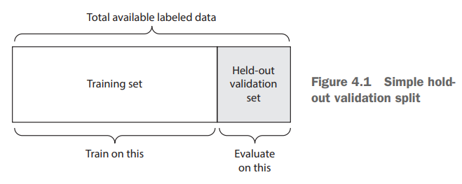
Simple held out validation

Slide 11
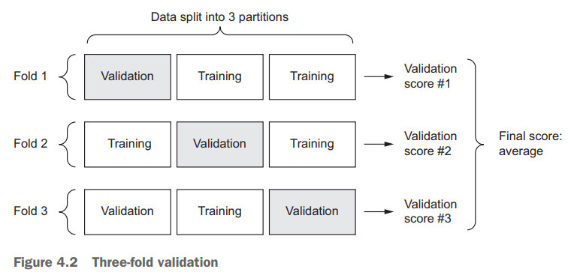
K-fold cross validation

Slide 12
Iterated k-fold validation
This one is for situations in which you have relatively little data available and you need to evaluate your model as precisely as possible.
I’ve found it to be extremely helpful in Kaggle competitions.
It consists of applying K-fold validation multiple times, shuffling the data every time before splitting it K ways.
The final score is the average of the scores obtained at each run of K-fold validation.
Note that you end up training and evaluating P × K models (where P is the number of iterations you use), which can very expensive.

Slide 13
Data representativeness
You want both your training set and test set to be representative of the data at hand.
For instance, if you’re trying to classify images of digits, and you’re starting from an array of samples where the samples are ordered by their class, taking the first 80% of the array as your training set and the remaining 20% as your test set will result in your training set containing only classes 0–7, whereas your test set contains only classes 8–9.
This seems like a ridiculous mistake, but it’s surprisingly common. For this reason, you usually should randomly shuffle your data before splitting it into training and test sets.

Slide 14
The arrow of time
If you’re trying to predict the future given the past (for example, tomorrow’s weather, stock movements, and so on), you should not randomly shuffle your data before splitting it, because doing so will create a temporal leak: your model will effectively be trained on data from the future.
In such situations, you should always make sure all data in your test set is posterior to the data in the training set

Slide 15
Redundancy in your data
If some data points in your data appear twice (fairly common with real-world data), then shuffling the data and splitting it into a training set and a validation set will result in redundancy between the training and validation sets.
In effect, you’ll be testing on part of your training data, which is the worst thing you can do! Make sure your training set and validation set are disjoint.

Slide 16
Vectorization
All inputs and targets in a neural network must be tensors of floating-point data (or, in specific cases, tensors of integers).
Whatever data you need to process—sound, images, text—you must first turn into tensors, a step called data vectorization

Slide 17
Normalization
Your data should have the following characteristics:
Take small values—Typically, most values should be in the 0–1 range
Be homogenous—That is, all features should take values in roughly the same range.
Normalize each feature independently to have a mean of 0.
Normalize each feature independently to have a standard deviation of 1.
x -= x.mean(axis=0)
x /= x.std(axis=0)

Slide 18
Handling missing values
What if this feature wasn’t available for all samples?
It’s safe to input missing values as 0
The network will learn from exposure to the data that the value 0 means missing data and will start ignoring the value.

Slide 19
Feature Engineering
Feature engineering is the process of using your own knowledge about the data and about the machine-learning algorithm at hand (in this case, a neural network) to make the algorithm work better by applying hardcoded (nonlearned) transformations to the data before it goes into the model.

Slide 20
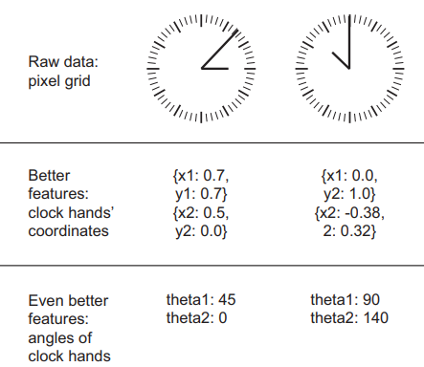

Slide 21
Which features are better?
Trying to develop a model that can take as input an image of a clock and can output the time of day
It’s easy to write a five-line Python script to follow the black pixels of the clock hands and output the (x, y) coordinates of the tip of each hand
You can go even further: do a coordinate change, and express the (x, y) coordinates as polar coordinates with regard to the center of the image. Your input will become the angle theta of each clock hand.

Slide 22
Deep Learning
Before deep learning, feature engineering used to be critical, because classical shallow algorithms didn’t have hypothesis spaces rich enough to learn useful features by themselves.
Fortunately, modern deep learning removes the need for most feature engineering, because neural networks are capable of automatically extracting useful features from raw data

Slide 23
Is feature engineering not useful now?
Good features still allow you to solve problems more elegantly while using fewer resources.
For instance, it would be ridiculous to solve the problem of reading a clock face using a convolutional neural network.
Good features let you solve a problem with far less data.

Slide 24
Overfitting and underfitting
The fundamental issue in machine learning is the tension between optimization and generalization.
Optimization refers to the process of adjusting a model to get the best performance possible on the training data (the learning in machine learning), whereas generalization refers to how well the trained model performs on data it has never seen before.
The goal of the game is to get good generalization, of course, but you don’t control generalization; you can only adjust the model based on its training data

Slide 25
To prevent a model from learning misleading or irrelevant patterns found in the training data, the best solution is to get more training data
If a network can only afford to memorize a small number of patterns, the optimization process will force it to focus on the most prominent patterns, which have a better chance of generalizing well
The processing of fighting overfitting this way is called regularization

Slide 26
Reducing the network’s size
The simplest way to prevent overfitting is to reduce the size of the model
In deep learning, the number of learnable parameters in a model is often referred to as the model’s capacity.
Intuitively, a model with more parameters has more memorization capacity
On the other hand, if the network has limited memorization resources, it won’t be able to learn this mapping as easily

Slide 27
Unfortunately, there is no magical formula to determine the right number of layers or the right size for each layer.
You must evaluate an array of different architectures

Slide 28
Solving the problem with different capacities
Let’s try networks of different sizes
Original network
Smaller network
Larger network

Slide 29
Adding weight regularization
Simpler models are less likely to overfit than complex ones.
Thus a common way to mitigate overfitting is to put constraints on the complexity of a network by forcing its weights to take only small values, which makes the distribution of weight values more regular.
This is called weight regularization, and it’s done by adding to the loss function of the network a cost associated with having large weights

Slide 30
Regularization
L1 regularization—The cost added is proportional to the absolute value of the weight coefficients (the L1 norm of the weights).
L2 regularization—The cost added is proportional to the square of the value of the weight coefficients (the L2 norm of the weights). L2 regularization is also called weight decay in the context of neural networks. Don’t let the different name confuse you: weight decay is mathematically the same as L2 regularization.

Slide 31
from keras import regularizers
model = models.Sequential()
model.add(layers.Dense(16,
kernel_regularizer=regularizers.l2(0.001), activation='relu', input_shape=(10000,)))
model.add(layers.Dense(16,
kernel_regularizer=regularizers.l2(0.001), activation='relu'))
model.add(layers.Dense(1, activation='sigmoid'))

Slide 32
Adding dropout
Dropout is one of the most effective and most commonly used regularization techniques for neural networks, developed by Geoff Hinton and his students at the University of Toronto
Dropout, applied to a layer, consists of randomly dropping out (setting to zero) a number of output features of the layer during training.

Slide 33
Let’s say a given layer would normally return a vector [0.2, 0.5, 1.3, 0.8, 1.1] for a given input sample during training.
After applying dropout, this vector will have a few zero entries distributed at random: for example, [0, 0.5, 1.3, 0, 1.1].
The dropout rate is the fraction of the features that are zeroed out; it’s usually set between 0.2 and 0.5.

Slide 34
Adding dropout
model = models.Sequential()
model.add(layers.Dense(16, activation='relu', input_shape=(10000,)))
model.add(layers.Dropout(0.5))
model.add(layers.Dense(16, activation='relu'))
model.add(layers.Dropout(0.5))
model.add(layers.Dense(1, activation='sigmoid'))

Slide 35
To recap, these are the most common ways to prevent overfitting in neural networks:
Get more training data.
Reduce the capacity of the network.
Add weight regularization.
Add dropout.

Slide 36
The universal workflow of machine learning: Defining the problem and assembling a dataset
First, you must define the problem at hand
What will your input data be? What are you trying to predict?
What type of problem are you facing? Is it binary classification? Multiclass classification?
One class of unsolvable problems you should be aware of is nonstationary problems

Slide 37
Suppose you’re trying to build a recommendation engine for clothing, you’re training it on one month of data (August), and you want to start generating recommendations in the winter

Slide 38
Choosing a measure of success
For balanced-classification problems, where every class is equally likely, accuracy and area under the receiver operating characteristic curve (ROC AUC) are common metrics.
For class-imbalanced problems, you can use precision and recall.
For ranking problems or multilabel classification, you can use mean average precision.
And it isn’t uncommon to have to define your own custom metric by which to measure success

Slide 39
Deciding on an evaluation protocol
Maintaining a hold-out validation set—The way to go when you have plenty of data
Doing K-fold cross-validation—The right choice when you have too few samples for hold-out validation to be reliable
Doing iterated K-fold validation—For performing highly accurate model evaluation when little data is available

Slide 40
Preparing your data
As you saw previously, your data should be formatted as tensors.
The values taken by these tensors should usually be scaled to small values: for example, in the [-1, 1] range or [0, 1] range
If different features take values in different ranges (heterogeneous data), then the data should be normalized.
You may want to do some feature engineering, especially for small-data problems.

Slide 41
Developing a model that does better than a baseline
Your goal at this stage is to achieve statistical power: that is, to develop a small model that is capable of beating a dumb baseline
If you can’t beat a random baseline after trying multiple reasonable architectures, it may be that the answer to the question you’re asking isn’t present in the input data

Slide 42
Things to consider
Last-layer activation—This establishes useful constraints on the network’s output. For instance, the IMDB classification example used sigmoid in the last layer; the regression example didn’t use any last-layer activation; and so on.
Loss function—This should match the type of problem you’re trying to solve. For instance, the IMDB example used binary_crossentropy, the regression example used mse, and so on.
Optimization configuration—What optimizer will you use? What will its learning rate be? In most cases, it’s safe to go with rmsprop and its default learning rate

Slide 43
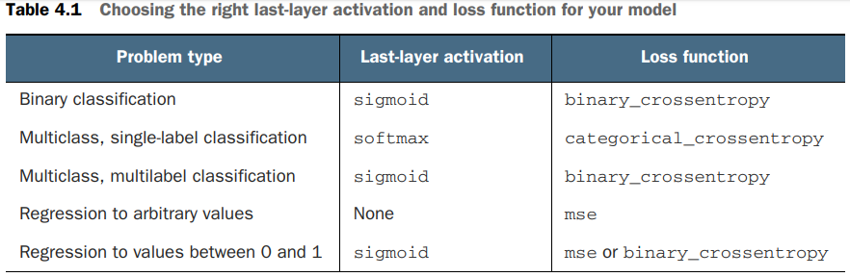

Slide 44
Scaling up: developing a model that overfits
To figure out how big a model you’ll need, you must develop a model that overfits. This is fairly easy:
Add layers.
Make the layers bigger.
Train for more epochs
Always monitor the training loss and validation loss, as well as the training and validation values for any metrics you care about.
When you see that the model’s performance on the validation data begins to degrade, you’ve achieved overfitting.

Slide 45
Regularizing your model and tuning your hyperparameters
This step will take the most time: you’ll repeatedly modify your model, train it, evaluate on your validation data (not the test data, at this point), modify it again, and repeat, until the model is as good as it can get
Add dropout.
Try different architectures: add or remove layers.
Add L1 and/or L2 regularization
Try different hyperparameters (such as the number of units per layer or the learning rate of the optimizer) to find the optimal configuration.
Optionally, iterate on feature engineering: add new features, or remove features that don’t seem to be informative

Slide 46
Conclusion
Define the problem at hand and the data on which you’ll train. Collect this data, or annotate it with labels if need be.
Choose how you’ll measure success on your problem. Which metrics will you monitor on your validation data?
Determine your evaluation protocol: hold-out validation? K-fold validation? Which portion of the data should you use for validation?

Slide 47
Develop a first model that does better than a basic baseline: a model with statistical power.
Develop a model that overfits.
Regularize your model and tune its hyperparameters, based on performance on the validation data. A lot of machine-learning research tends to focus only on this step—but keep the big picture in mind.

